Slide 1
The Era of Restriction

Slide 2
By: Kalicia Szabo

Slide 3
1917
A literacy test for incoming immigrants finally becomes a law. Previously this legislation was vetoed by three different presidents. Now the bill has passed the veto of president Woodrow Wilson. For the first time congress enacts a general restriction of immigrants. Although any adult unable to read a language were excluded.

Slide 4
1919
Many Americans panic two years after the Russian Revolution succeeds. They believe the nation is threatened by a communist menace and thousands of immigrants are seized and deported for their communist beliefs.

Slide 5
1920
After a treacherous struggle and a wait that seemed to never end, the 19th amendment declared women's rights. This gave them the right to vote and respect to be treated equally with the men of our nation.

Slide 6
1924
Congress passes a national origins act. This reduced the number of potential immigrants to 300,000 annually and sets 1890 as the base year for determining the quota of those eligible.

Slide 7
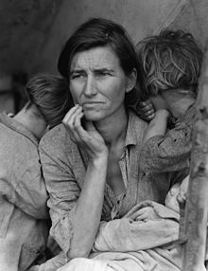
1929
The stock market on Wall Street crashes. Many are left homeless and without jobs. Our working class must rebuild from the ground up. So many people were left poor and hungry. This sent our country spiraling into what is known today as The Great Depression. President Franklin D Roosevelt pulled our nation out of the rut and created manual labor jobs to help boost the economy.

Slide 8
1938
World War two begins in Europe. Lasting from 1939-1945 this would be known as one of the most brutal wars in history. It will forever be famous and dreaded because of Germanys persecution of the Jews and the Halocaust.Millions of people with Jewish origin were sent to death camps were they were put in gas chambers or worked to death.

Slide 9
1941
The Japanese bomb pearl harbor and the U.S finally enters WWII. Later in 1945 the war ends with the first ever deployed nuclear bomb. It landed in Hiroshima and would forever change the tactics of war and everything that we thought possible.

Slide 10
1954
President Eisenhower created a border control program. It was called operation wetback. It cut illegal immigration at the cost of anti-Latino discrimination.

